Slide 1
Edil Monica project 03oct2021
File created on: 8/2/2022 4:36:35 PM

Slide 2
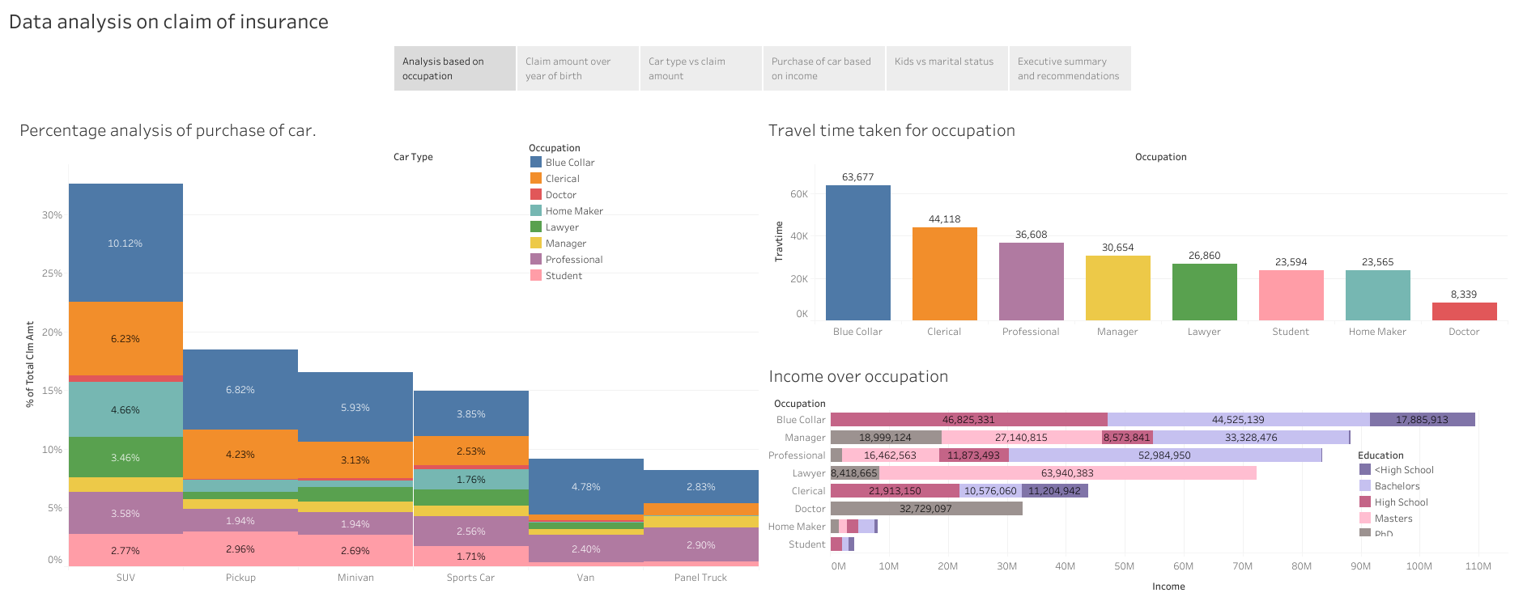

Slide 3
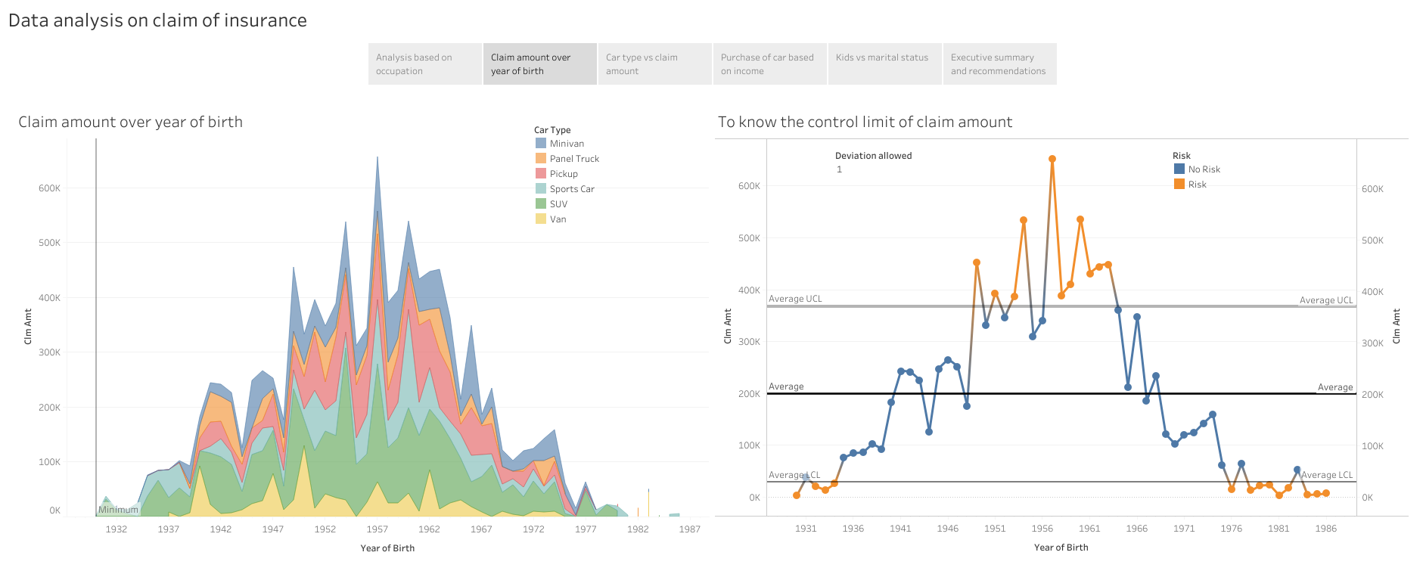

Slide 4
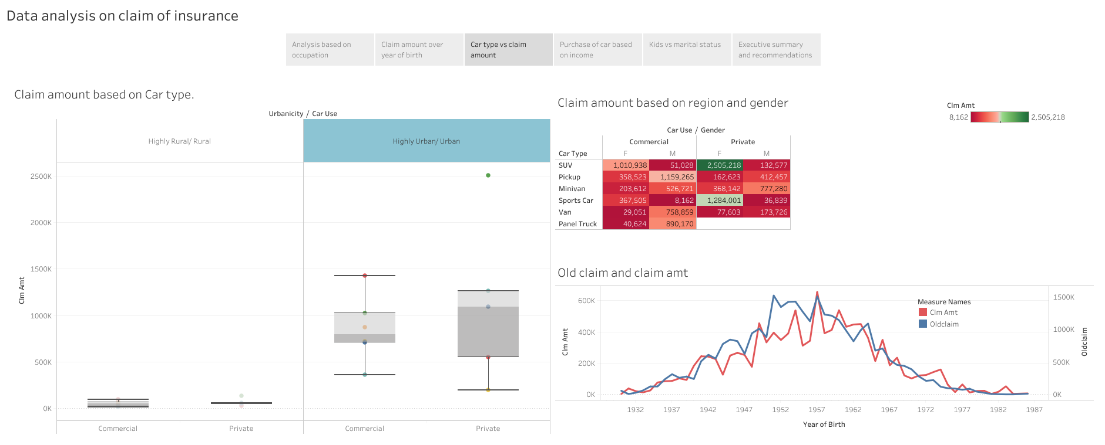

Slide 5
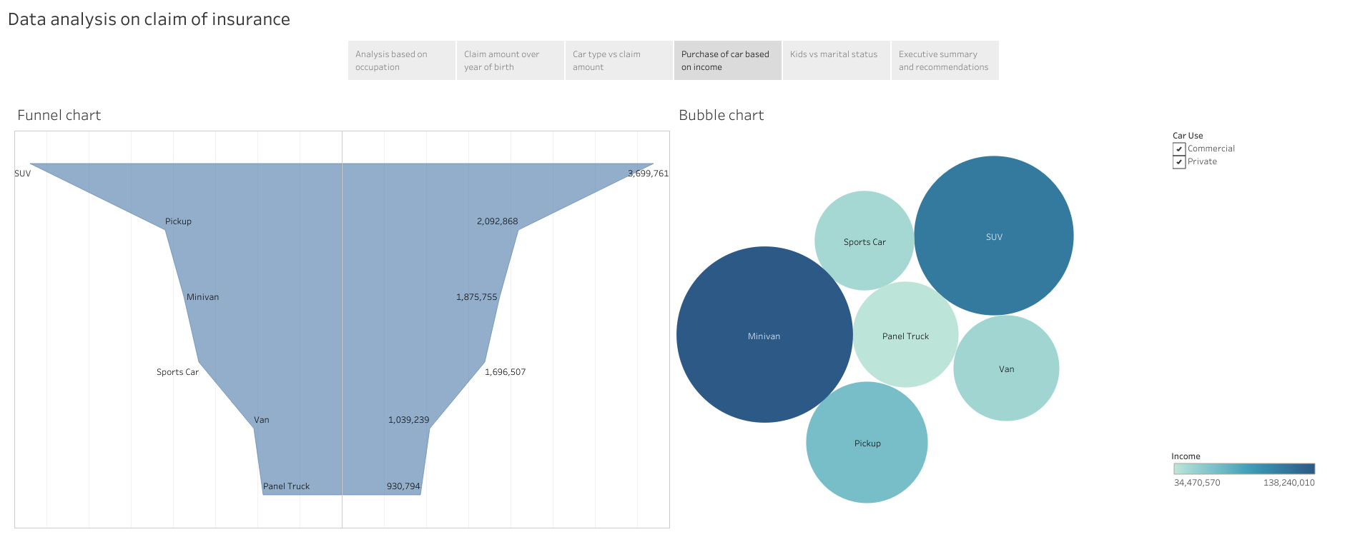

Slide 6
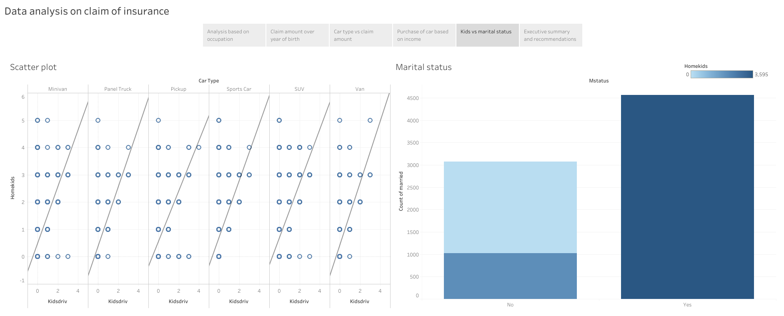

Slide 7
